Slide 1
AI-Driven Litigation Risk in Consumer Financial Services
From Code to Courtroom:
Francis X. Riley III
Partner
Head of Consumer Financial Services Litigation Practice
Saul Ewing
Jeremy Potter
Chief Business Officer
Kelley Blue Book Homes
Notes:
Note: It is unclear whether “threat to self” passes muster under Title III. OCR says it does not under Title II (which applies to state and local government). But as will be repeated, do what is right. Which “lawsuit” would you rather face?

Slide 2



Speakers
Francis X. Riley III
SUBSCRIBE TO RECEIVE LEGAL UPDATES:
Matt Kohel
Partner
Head of Consumer Financial Services Litigation Practice
Saul Ewing LLP
P: 609-452-3150
E: francis.riley@saul.com
Partner, Saul Ewing LLP
Jeremy Potter
Chief Business Officer
Kelley Blue Book Homes

Slide 3
What We’ll Cover Today
1
Where AI use in loan origination and servicing creates private litigation exposure.
2
How state consumer protection statutes are being leveraged against AI-driven practices.
3
Emerging AI-specific state laws and how they expand theories of liability.
4
Litigation patterns developing in AI-related consumer finance cases.
Notes:
Creating and following a safety plan can help show responsible discharge of duties, though it could create duties, too, so it’s important to follow through on what the plan requires.
Also be familiar with your state’s telehealth-related laws and regulations and cross-state licensing restrictions, and ideally those of other states where your students are learning remotely.
As of October 13, 2020, there are no federal provisions that allow mental health professionals to practice teletherapy over state lines; you must register or become licensed in your client’s state to provide teletherapy. However, there have been federal recommendations for states to relax licensure requirements. The federal Center for Medicare and Medicaid Services (CMS) has also implemented policies expanding telehealth access and delivery across states. As a result, certain states have ordered waivers on certain licensure requirements for the duration of the crisis or beyond. https://blog.zencare.co/teletherapy-across-state-lines-coronavirus/

Slide 4
Risk Exposure Under State Consumer Protection Statute
A
Fannie and Freddie AI Guidance
B
New Jersey Consumer Fraud Act (CFA) – N.J.S.A. 56:8-1 et seq.
C
Pennsylvania UTPCPL – 73 P.S. § 201-1 et seq.
D
New York General Business Law § 349
E
Massachusetts Chapter 93A
F
California – CLRA & Related Consumer Statutes
Notes:
Creating and following a safety plan can help show responsible discharge of duties, though it could create duties, too, so it’s important to follow through on what the plan requires.
Also be familiar with your state’s telehealth-related laws and regulations and cross-state licensing restrictions, and ideally those of other states where your students are learning remotely.
As of October 13, 2020, there are no federal provisions that allow mental health professionals to practice teletherapy over state lines; you must register or become licensed in your client’s state to provide teletherapy. However, there have been federal recommendations for states to relax licensure requirements. The federal Center for Medicare and Medicaid Services (CMS) has also implemented policies expanding telehealth access and delivery across states. As a result, certain states have ordered waivers on certain licensure requirements for the duration of the crisis or beyond. https://blog.zencare.co/teletherapy-across-state-lines-coronavirus/

Slide 5
2026 Fannie Mae Lender Letter
Fannie Mae Lender Letter LL-2026-04 (April 8, 2026): Framework for Seller/Servicers’ use of artificial intelligence and/or machine learning (AI/ML) in origination and servicing of loans sold to or guaranteed by Fannie Mae. (singlefamily.fanniemae.com)
Effective: August 2026. No ban or pre-approve specific tools. Requires AI/ML used in connection to comply with applicable law and the Lender Contract, plus these additional obligations:
  Maintain written policies and procedures covering development, implementation, use, maintenance, and risk measurement/management of any AI/ML system. At a minimum those policies must:
  be transparent and communicated to relevant personnel;
  incorporate characteristics of trustworthy and ethical AI/ML;
  reflect legal and regulatory requirements;
  align risk management with the institution’s risk tolerance; and
  have designated owner(s) who implement, maintain, and review them at least annually for legal compliance and industry best practices.
  Comply with Fannie Mae’s Information Security and Business Resiliency Supplement.
  Apply governance to subcontractors and vendors that is no less protective than the above requirements.

Slide 6
2026 Fannie Mae Lender Letter [cont.]
Upon Fannie Mae’s request, the seller/servicer must promptly disclose the types of AI/ML used, the purpose and manner of use, the safeguards in place, and any other information Fannie Mae requires.
Fannie Mae Multifamily issued a parallel Lender Letter with essentially the same requirements for multifamily lenders.

Slide 7
Freddie Guidance
Freddie Mac’s artificial intelligence guidance requires approved single-family sellers and servicers to implement a comprehensive risk management and governance framework for any AI or machine learning (ML) systems used in loan origination or servicing.
(https://guide.freddiemac.com/app/guide/section/1302.8)

Slide 8
New Jersey Consumer Fraud Act (CFA) – N.J.S.A. 56:8-1 et seq.
Risk Themes:
Exposure Drivers:
Allegations of deceptive AI-driven marketing (“instant approval,” “bias-free decisions,” “objective underwriting”).
Failure to disclose material limitations of automated underwriting or servicing tools.
Automated account actions causing ascertainable loss.
Treble damages.
Attorneys’ fees.
Broad definition of “unlawful practice.”

Slide 9

Pennsylvania UTPCPL – 73 P.S. § 201-1 et seq.
Repurchase & Compliance Risk: Algorithmic errors driving loan buyback and fair lending exposure.
Risk Themes:
Alleged deceptive conduct in automated loan modification or hardship processing.
Misleading chatbot interactions.
Representations about speed, personalization, or approval likelihood.
KEY ISSUE: Justifiable reliance in digital and AI-mediated communications.

Slide 10
New York General Business Law § 349
Repurchase & Compliance Risk: Algorithmic errors driving loan buyback and fair lending exposure.
Risk Themes:
“Consumer-oriented” AI practices with allegedly misleading effects.
Failure to disclose automated decisioning affecting account access.
Algorithmic pricing or risk-based servicing framed as deceptive.
EXPOSURE:
Statutory damages.
Strong class certification potential due to uniform automated conduct.

Slide 11
Massachusetts Chapter 93A
RISK THEMES:
  Automated servicing errors affecting payment processing or late fees.
  AI-generated collection communications.
  Allegations of unfair or oppressive automated conduct.
  Strategic Feature:
  93A demand letters used as pre-suit leverage.

Slide 12
California – CLRA & Related Consumer Statutes
Consumers Legal Remedies Act (CLRA):
Overlap with CCPA/CPRA ADMT Regulations
(effective 2026+):
Misrepresentations regarding AI-driven underwriting or loan features.
Opaque personalization practices.
Failure to provide required automated decision-making notices.
Alleged failure to honor opt-out rights.
Profiling claims involving significant consumer effects.

Slide 13
Federal Statutory Exposure
FTC, CFPB & GSE
    Be practical yet operationally mature.
    Be practical yet operationally mature.
ADVERTISING OF EFFECTIVENESS AND ACCURACY
AUDITABLE GOVERNANCE PROTOCOL

Slide 14
Federal Statutory Exposure
Equal Credit Opportunity Act (ECOA)
15 U.S.C. §§ 1691–1691f
Repurchase & Compliance Risk: Algorithmic errors driving loan buyback and fair lending exposure.
15 U.S.C. § 1691(a) - Prohibited Discrimination
“It shall be unlawful for any creditor to discriminate against any applicant, with respect to any aspect of a credit transaction
(1) on the basis of race, color, religion, national origin, sex or marital status, or age (provided the applicant has the capacity to contract);
(2) because all or part of the applicant’s income derives from any public assistance program; or
(3) because the applicant has in good faith exercised any right under this chapter.”

Slide 15
Federal Statutory Exposure
Risk Themes (Non-Discrimination Focus):
Inadequate adverse action explanations generated by AI systems.
Failure to provide specific principal reasons for denial or credit limit reduction.
Boilerplate or vague automated notices.
Common Allegations:
“Opaque decision-making.”
Failure to meaningfully explain automated determinations.
Notes:
Creating and following a safety plan can help show responsible discharge of duties, though it could create duties, too, so it’s important to follow through on what the plan requires.
Also be familiar with your state’s telehealth-related laws and regulations and cross-state licensing restrictions, and ideally those of other states where your students are learning remotely.
As of October 13, 2020, there are no federal provisions that allow mental health professionals to practice teletherapy over state lines; you must register or become licensed in your client’s state to provide teletherapy. However, there have been federal recommendations for states to relax licensure requirements. The federal Center for Medicare and Medicaid Services (CMS) has also implemented policies expanding telehealth access and delivery across states. As a result, certain states have ordered waivers on certain licensure requirements for the duration of the crisis or beyond. https://blog.zencare.co/teletherapy-across-state-lines-coronavirus/

Slide 16
Emerging AI-Specific State Statutes & Litigation Implications
    Be practical yet operationally mature.
New AI statutes introduce additional duties that may:
Be enforced by Attorneys General.
Serve as predicate acts under broader consumer protection laws.
Inspire parallel or follow-on private litigation.
Notes:
QUESTION: What sorts of course accommodations can be made for stress-related mental health issues? Is there a new normal after the pandemic?
Following the pandemic, during which many schools operated remotely for a long time, it can be tricky to argue fundamental alteration OR undue burden for using remote classes an accommodation.
Might have been able to before in certain circumstances, for classes that truly require in-person participation and collaboration with classmates.
But the Calculus has probably shifted a little bit now. Schools have the technology and experience in place now to conduct most courses remotely. Is there a new normal now?

Slide 17
Colorado AI Act (SB 24-205 → SB 26-189; effective 2027)
Applies to “high-risk” AI systems influencing consequential decisions (including credit).
Enforced via the Colorado Consumer Protection Act.
Civil penalties up to $20,000 per violation.
Implication:
Alleged statutory violations may be pled as “unlawful practices.”
Risk assessments and internal documentation may become focal points in discovery.

Slide 18
Utah Artificial Intelligence Policy Act (SB 149)
Requires disclosure when consumers interact with generative AI in certain contexts.
Effective May 1, 2024 (amendments narrowed scope in 2025).
Risk:
Failure-to-disclose claims involving AI chatbots in financial services.
Allegations that undisclosed automation misled consumers.

Slide 19
California AI Transparency & ADMT Rules
Notice and opt-out requirements for automated decisions producing significant effects.
Training data and transparency obligations for certain AI systems.
Effective dates largely 2026 onward.
Risk:
Class actions alleging lack of required notice.
Profiling or automated pricing challenges.

Slide 20
Texas Responsible AI Governance Act (Effective Jan. 1, 2026)
Prohibits certain harmful AI uses.
Enforced by the Attorney General.
Safe harbor tied to NIST AI RMF compliance.
Implication:
AG enforcement actions may precede or parallel private litigation.
Allegations of prohibited manipulation or harmful AI practices.

Slide 21
Other States & Privacy Law Overlay
Repurchase & Compliance Risk: Algorithmic errors driving loan buyback and fair lending exposure.
Illinois AI Safety Measures Act and related AI statutes.
New York AI safety initiatives and local rules.
Connecticut, Nebraska, and others regulating AI in pricing, insurance, or chatbot use.
Nearly 20 states regulate profiling or automated decision-making under comprehensive privacy laws.
TREND: AI-driven consumer lending increasingly intersects with privacy-based claims tied to automated decisions producing legal or significant effects.

Slide 22
Risk Patterns in AI Consumer Finance Cases
1
Uniform Algorithms Strengthen Class Allegations and/or Antitrust
Automation can support commonality and predominance arguments. Conspiracy to fix pricing.
2
Marketing Language Becomes Central Evidence
Claims such as “objective,” “instant,” “fair,” or “AI-powered transparency” are closely scrutinized.
3
Technical Failures Become Unfairness Claims
System errors or unexplained decisions are framed as deceptive or unfair practices.
4
Discovery Focuses on Internal Model Testing and Communications
Plaintiffs seek validation studies, internal analyses, and performance metrics.
5
Statutory Damages Drive Settlement Pressure
Consumer protection statutes amplify financial exposure even absent large individual harm.

Slide 23
sIX Key Takeaways
1
AI in Consumer Lending Is Now a Private Litigation: Target Plaintiffs are actively adapting traditional consumer protection statutes to automated systems.
2
Automated Uniformity Increases Class Action Risk: Standardized decision logic can create scalable exposure.
3
Disclosure and Explanation Failures Are Recurring Triggers
4
Vague or generic AI-generated notices frequently anchor complaints.
5
Emerging AI Laws Expand the Liability Landscape: New statutory duties create additional avenues for claims.
6
Early Case Trends Show Courts Engaging with AI Decisioning: Judges are increasingly willing to examine how automated systems affect consumers.

Slide 24
Speakers
Francis X. Riley III
SUBSCRIBE TO RECEIVE LEGAL UPDATES:
Matt Kohel
Partner
Head of Consumer Financial Services Litigation Practice
Saul Ewing LLP
P: 609-452-3150
E: francis.riley@saul.com
Partner, Saul Ewing LLP
Jeremy Potter
Chief Business Officer
Kelley Blue Book Homes

Slide 25
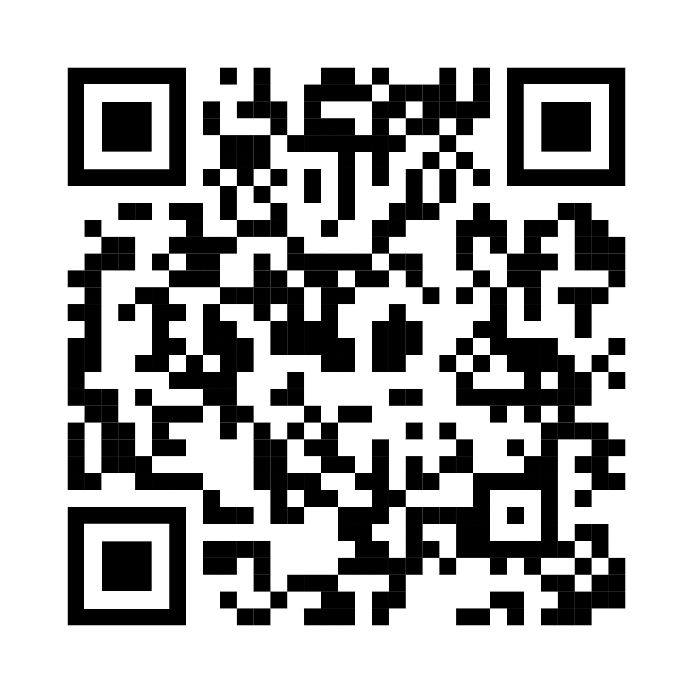
Don’t Miss our November 12th Annual Consumer Finance Webinar!
CONSUMER FINANCIAL SERVICES ANNUAL UPDATE:
COURTS, REGULATORS & THE IN-HOUSE PERSPECTIVE
Thursday, November 12th from 1-4 PM ET
REGISTER HERE:
Disputes, Damages & Default Judgments: Navigating the FCRA/FDCPA Landscape
When Washington Steps Back, the States
Step Up: The State AG Enforcement Wave
In-House Counsel Perspectives on
Origination, Servicing & the Road Ahead

